Slide 1
MEMS and Microsystems

Slide 2
Introduction:
Many Microsystems use microelectronics materials such as silicon, and gallium arsenide (GaAs) for the sensing and actuating elements.
Reasons: (1) dimensionally stable; (2) well-established fabricating and packaging techniques.
However, there are other materials used for MEMS and Microsystems products: - Such as quartz and Pyrex, polymers and plastics, and ceramics. (not common in microelectronics)

Slide 3
Substrates and Wafers:
Substrate:
In microelectronics, substrate is a flat macroscopic object on which microfabrication processes take place.
In microsystems, a substrate serves an additional purpose: - Act as signal transducer besides supporting other transducers that convert mechanical actions to electrical outputs or vice versa.
Wafer:
In semiconductors, the substrate is a single crystal cut in slices from a larger piece call a wafer (which can be of silicon or other single crystalline materials such as quartz or gallium arsenide).
In microsystems, there are two types of substrate materials:
Active substrate material. 2. Passive substrate material.
Material classifications:
Insulators: electric resistivity ρ>10^8 Ω-cm
Semiconductors: 10^-3<ρ<10^8 Ω-cm
Conductors: ρ<10^-3 Ω-cm
In MEMS, common substrate materials (silicon Si, germanium, gallium arsenide GaAs) all fall in the category of semiconductors.
Why? - They are at the borderline between conductors and insulators, so they can be made either a conductor or an insulator as needed. → Can be converted to a conducting material by doping (p- or n-type). - The fabrication processes (e.g., etching) and the required equipment have already been developed for these materials.

Slide 4
Active Substrate Materials
Active substrate materials are primarily used for sensors and actuators in Microsystems
Typical materials: Si, GaAs, Ge, and quartz. (All except quartz are classified as semiconductors)
Have a cubic crystal lattice with tetrahedral atomic bond.
Reason for active substrate materials:
dimensional stability
Insensitive to environmental conditions.
A critical requirement for sensors and actuators with high precision.
Each atom carries 4 electrons in the outer orbit, and shares these 4 electrons with its 4 neighbours.

Slide 5
Silicon as A ideal substrate Material
Single-crystal silicon is the most widely used substrate material for MEMS and microsystem. The reasons are:
1. (a) Mechanically stable; (b) can be integrated with electronics for signal transduction on the same substrate.
2. An ideal structural material because of high Young’s modulus (which can better maintain a linear relationship between applied load and the induced deformation) and light weight. - About the same as steel (about 2×10^5 MPa) - As light as aluminum with a mass density of about 2.3 g/cm3 .
3. High melting point at 1400℃ - About twice as high as that of aluminum. - Dimensionally stable.
4. Low thermal expansion coefficient - About 8 times smaller than that of steel. - More than 10 times smaller than that of aluminum.
5. (a) Show virtually no mechanical hysteresis → An ideal candidate material for sensors and actuators. (b) Extremely flat and accept coatings and additional thin-film layers for building microstructures and conducting electricity.
6. Treatment and fabrication processes for silicon substrate are well established and documented.

Slide 6
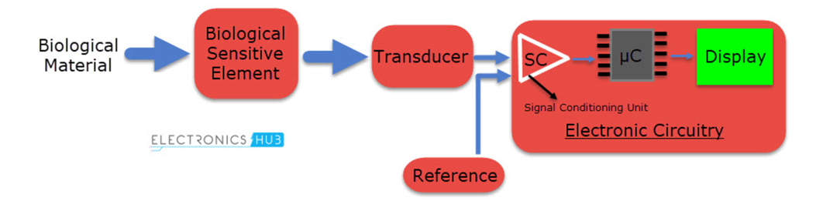
Working principle of biosensor
The desired biological material is usually in the form of an enzyme. By a process known as Electroenzymatic approach, which is a chemical process of converting the enzymes into corresponding electrical signals (usually current) with the help of a transducer.
One of the commonly used Biological response is the oxidation of the enzyme. Oxidation acts as a catalyst and alters the pH of the biological material. The change in pH will directly affect the current carrying capacity of the enzyme, which is once again, in direct relation to the enzyme being measured.

Slide 7
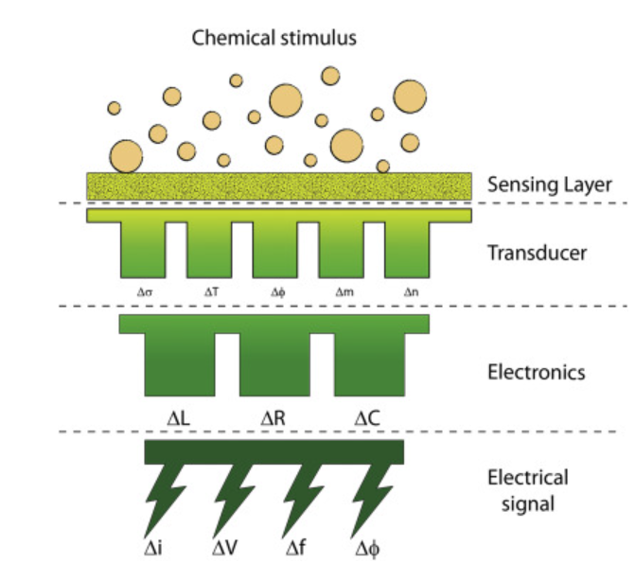
Working principle of Chemical sensor
The working principle of an electrochemical sensor depends on the electrochemical effect among the analyte molecules and featured electrodes. The mass sensor depends on the quality change induced by the mass loading from the adsorption toward the analyte by the special modification of the sensor surface. The optical chemical sensor is based on the changes in optical properties, which results from the interaction between the analyte and the receptor. The magnetic device is based on the changes in the magnetic properties during analyte adsorption, whereas the thermal sensor is based on the thermal effect generated by the specific chemical reaction or adsorption process between analyte and receptor surface.

